Slide 1
The Cycle Analyst and
Capturing its Serial Line data with asyncio
Hamilton Python Users Group
9 October 2017
Ian Stewart
Disclaimer: The Cycle Analyst is a product designed, manufactured and retailed by Grin Technologies Ltd. of Vancouver, Canada. www.ebikes.ca
Ian Stewart has no business relationship with Grin Technologies.

Slide 2
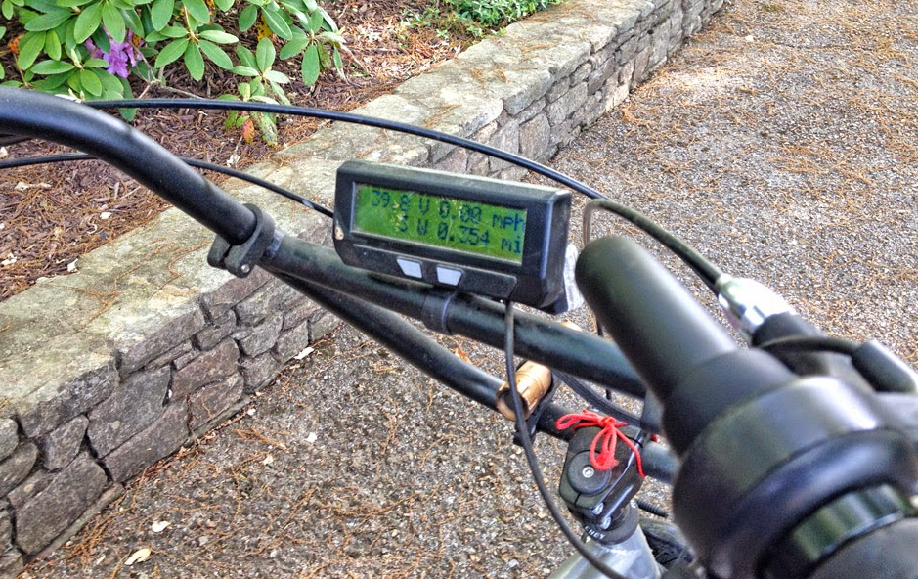
Cycle Analyst mounted on electric bike

Slide 3
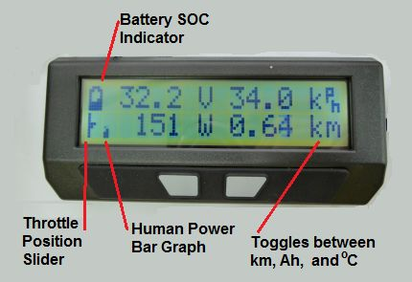
Cycle Analyst – Main Screen (1 of 12)

Slide 4
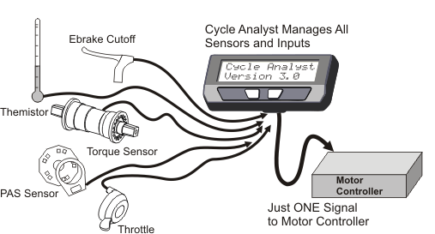
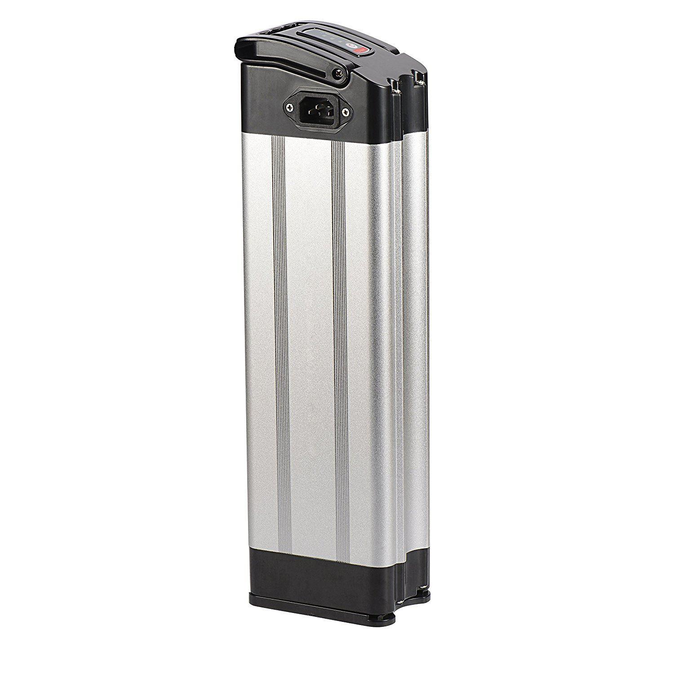
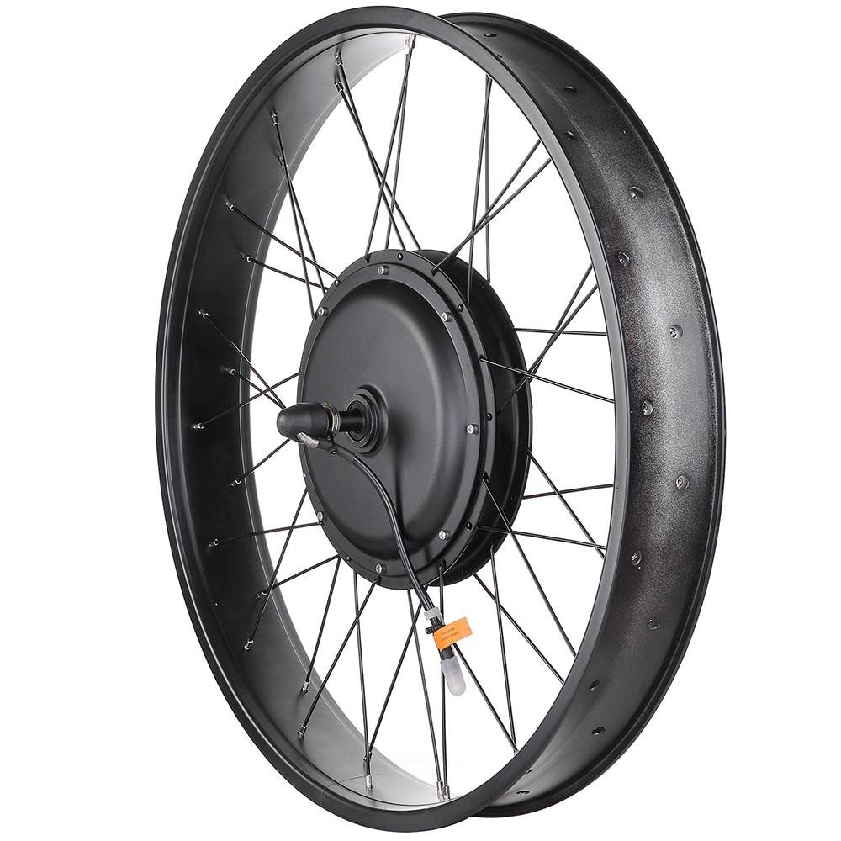
Electric Bike – Cycle Analyst – Data Out
Cycle Analyst
Data Out/In TTL
48Volt Rechargable battery
Brushless DC 3 phase hub motor

Slide 5
Data Out
UART TTL Serial Output (and Input)
Output Record every second. Or 5 per second.
Each record: 14 fields tab delimited string values
Input signal for firmware upgrades

Slide 6
Record of Data Serial Line
14 x Tab Delimited Fields. 13 Float strings, 1 string
Ah Amp Hours
V Battery Voltage
A Amps Current Draw or Regenerative
S Speed km/h
D Distance Travelled km
Deg Temperature Hub
RPM Revolution per minute - Cadence
HW Human Watts
Nm Newton Meters - Peddle Assist
ThI Throttle In
ThO Throttle Out
AuxA Auxilary Input Analog
AuxD Auxillary Input Digital
Flgs Flags. B = Brakes, S = Overspeed, etc.

Slide 7
Example Data
2.9205 52.58 -5.51 12.17 7.7010 0.0 0.0 0 0.0 4.19 0.00 0.00 0.00 1B
2.9205 amp/hours
52.58 volts
-5.51 amps
12.17 km/h
7.7010 km
0.0
0.0
0
0.0
4.19 Throttle In
0.00 Throttle Out
0.00
0.00
1B Flags: B=Brakes on
Applying Brakes.
Regenerative braking generating 5.51 amps.
290 Watts

Slide 8
Block Diagram / Data Flow
Client:
Pydbus: Subscribe to
System Dbus
Cycle Analyst
Replace with R-Pi to simulate data
Filter / Process.
Output Data as Audio
Filter / Process.
Output Data as Audio
ttl to USB
converter
cable
Future:
Pydbus Method Call
System D-Bus
Read ttyUSB0
Data
Using Asyncio
Server:
Pydbus: Publish Data onto System Dbus
Using Asyncio
Future: Method Calls

Slide 9
Serial Line Capture / Publish on D-Bus - part1
import serial
import asyncio
import random
from pydbus import SystemBus
from pydbus.generic import signal
device = "/dev/ttyUSB0"
timeout_seconds = 2
iface_name = "org.example.ca.server"
bus = SystemBus()
loop = asyncio.get_event_loop()
---cut. Next slide has the code that goes here---
async def main_task():
while True:
line = await serial_read_line()
# publish data list on the System D-Bus
emit.app_signal(line)
if __name__=="__main__":
print("Server starting with logging")
# Setup server to emit signals over the DBus
emit = Server_XML()
bus.publish(iface_name, emit)
# Add tasks
loop.create_task(random_number())
loop.create_task(main_task())
loop.run_forever()

Slide 10
Serial Line Capture / Publish on D-Bus - part2
serial_device = serial.Serial(port=device, baudrate=9600, bytesize=8,
parity='N', stopbits=1,
timeout=timeout_seconds,
xonxoff=False, rtscts=False,
dsrdtr=False)
---cut---
async def serial_read_line():
done = loop.create_future()
def input_available():
done.set_result(True)
result = ""
while True:
loop.add_reader(serial_device, input_available)
await done
loop.remove_reader(serial_device)
line_bytes = serial_device.readline()
# Do the decoding seperately so data corruption of line can be trapped
try:
line_text = line_bytes.decode('utf-8')
# print(type(line_text)) # <class 'str'>
except UnicodeDecodeError as e:
print("Error: {}".format(e))
continue
return line_text

Slide 11
Monitoring the Server with gdbus utility
$ gdbus monitor --system --dest org.example.ca.server
Monitoring signals from all objects owned by org.example.ca.server
The name org.example.ca.server is owned by :1.1727
/org/example/ca/server: org.example.ca.server.app_signal ('2.3144\t52.40\t0.04\t0.00\t6.8233\t0.0\t0.0\t0\t0.0\t0.83\t0.99\t0.00\t0.00\t1\n',)
/org/example/ca/server: org.example.ca.server.app_signal ('2.3144\t52.40\t0.07\t0.00\t6.8233\t0.0\t0.0\t0\t0.0\t4.21\t1.97\t0.00\t0.00\t1A\n',)
---continues with output every second--
Record of data made easier to read by stripping the tabs...
2.3144 52.40 0.04 0.00 6.8233 0.0 0.0 0 0.0 0.83 0.99 0.00 0.00 1 \n

Slide 12
Simple Server App.
import asyncio
import random
from pydbus import SystemBus
from pydbus.generic import signal
iface_name = "org.example.ca.server"
bus = SystemBus()
loop = asyncio.get_event_loop()
class Server_XML(object):
dbus = """
<node>
<interface name="org.example.ca.server">
<signal name="app_signal">
<arg type='s'/>
</signal>
</interface>
</node>
"""
app_signal = signal()
async def emit_random_number():
"Emit a message every second with random integer between 0 and 100."
while True:
x = random.randrange(100)
message = "The random integer for this second is {}".format(x)
print(message)
emit.app_signal(message)
await asyncio.sleep(1)
if __name__=="__main__":
emit = Server_XML()
bus.publish(iface_name, emit)
loop.create_task(emit_random_number())
loop.run_forever()

Slide 13
Simple Client App.
import sys
from gi.repository import GLib
from pydbus import SystemBus
# Instantiation / Variables / Constants
iface_name = "org.example.ca.server"
bus = SystemBus()
loop = GLib.MainLoop()
bus_name = "org.example.ca.server"
dbus_filter = "/" + "/".join(bus_name.split("."))
# print(dbus_filter) # /org/example/ca/server
def cb_server_signal_emission(*args):
"""
Callback on emitting signal from server
Emitted signal is the value of the counter
Data is in args[4]. The first item in a tuple.args[4][0]
"""
data = args[4][0]
print(data)
if __name__=="__main__":
print("Client Starting...")
# Subscribe to bus to monitor for server signal emissions
# dbus_filter. E.g. /org/example/ca/server
bus.subscribe(object = dbus_filter, signal_fired = cb_server_signal_emission)
loop.run()

Slide 14
Asyncio for Async Serial Line
Demo Simple Server
...with gdbus utility
...with Simple Client
Demo R-Pi generating Cycle Analyst data
Server to capture ttl data and publish data
Client subscribes to D-Bus

Slide 15
Update
Using Server with Asyncio Loop with pydbus.
The server is able to publish data on the D-Bus.
Testing of method calls has found that the method call will hang and data is not returned from the server to the client through the D-Bus.
Using Server with Glib Loop with pydbus.
Capable of both publishing data onto the D-Bus and the processing of method calls.

